Slide 1
Presentation brief for MCT’s
Title of presentation | Deploying and Consuming Models
Presentation length | 120 minutes (including labs)
Audience | Data Scientists planning to operate machine learning workloads on Azure
Purpose | Describe how to deploy and consume real-time inferencing services Describe how to deploy and consume batch inferencing services
(think) Student key takeaways | Real-time inferencing requires suitable compute for request load and security requirements Batch inferencing is a similar pattern to training pipelines
(feel) Student desired mindset | Confident in choosing a deployment option
(do) Student outcomes | Deploy a model as a real-time service Deploy a batch inference pipeline
More information | For course feedback, please use the MCT Forums

Slide 2

Module 7: Deploying and Consuming Models

Slide 3
Agenda
Real-time Inferencing
Batch Inferencing

Slide 4



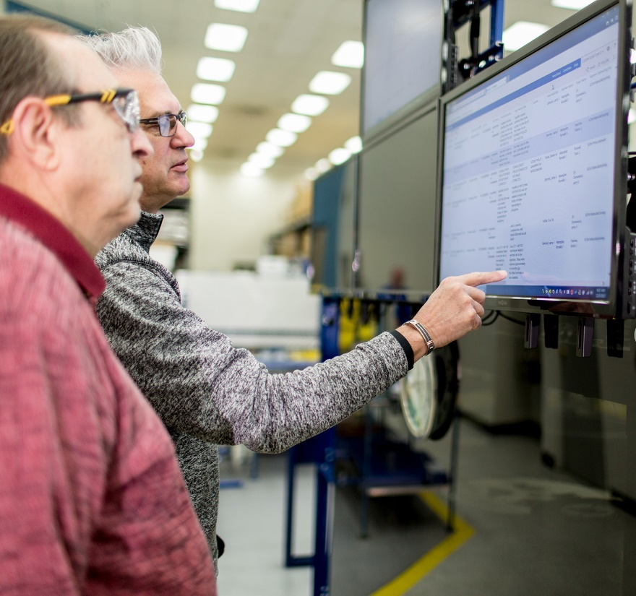









Lesson 1
Real-time Inferencing
Data
Cloud
AI

Slide 5



What is Real-Time Inferencing?
Immediate prediction from new data
Usually deployed as a web service endpoint
y=1

Slide 6
Deploying a Real-Time Inferencing Service
Register a trained model
Define an Inference Configuration
Create a scoring script (implement init() and run() functions to load the model and return predictions)
Create an environment (use a Conda configuration file)
Define a Deployment Configuration
Create a Compute Target (for example: local, Azure Container Instance, AKS cluster)
Deploy the model as a service

Slide 7
Consuming a Real-time Inferencing Service
Use the SDK
Use the REST Endpoint
import json
x_new = [[0.1,2.3,4.1,2.0],[0.2,1.8,3.9,2.1]] # Array of feature vectors
json_data = json.dumps({"data": x_new})
response = service.run(input_data = json_data)
predictions = json.loads(response)
import json
import requests
x_new = [[0.1,2.3,4.1,2.0],[0.2,1.8,3.9,2.1]] # Array of feature vectors
json_data = json.dumps({"data": x_new})
request_headers = { 'Content-Type':'application/json' }
response = requests.post(url=endpoint, data=json_data, headers=request_headers)
predictions = json.loads(response.json())

Slide 8
Troubleshooting a Real-Time Inferencing Service
Check the service state
Review service logs
Deploy to a local container
Modify entry script to debug, and then reload to test
print(service.state)
print(service.get_logs())
deployment_config = LocalWebservice.deploy_configuration(port=8890)
service = Model.deploy(ws, 'test-svc', [model], inference_config, deployment_config)
service.reload()
service.run(input_data=test_sample)

Slide 9
Lab 7A
Creating a Real-time Inferencing Service
https://aka.ms/msl-dp100

Slide 10
Lesson Review
Complete the Review Questions

Slide 11
Lesson 2
Batch Inferencing
Data
Cloud
AI

Slide 12



What is Batch Inferencing?
Asynchronous prediction from batched data
Implemented as a pipeline
y

Slide 13
Creating a Batch Inferencing Pipeline
Register the model
Create a scoring script
Implement init() and run(mini_batch) functions to load the model and return predictions for each mini-batch
Create a pipeline with a ParallelRunStep to run the script
Define a File dataset input for the batch data
Define a PipelineData reference for the output folder
Configure with an output_action of "append_row" so all results are collated in parallel_run_step.txt.
Retrieve batch predictions from the output

Slide 14
Publishing a Batch Inferencing Service
Publish the batch pipeline as a REST service
Use the pipeline endpoint to initiate batch inferencing
published_pipeline = pipeline_run.publish_pipeline(name='Batch_Prediction_Pipeline',
description='Batch pipeline',
version='1.0')
rest_endpoint = published_pipeline.endpoint
import requests
response = requests.post(rest_endpoint,
headers=auth_header,
json={"ExperimentName": "Batch_Prediction"})
run_id = response.json()["Id"]

Slide 15
Lab 7B
Creating a Batch Inferencing Service
https://aka.ms/msl-dp100

Slide 16
Lesson Review
Complete the Review Questions

